Slide 1
Supervised
Machine
Learning
Capstone Project
Credit Card
Approval Through
Predictive Algorithms
Presented By: Team 05
Aekansh Singh, Deepak Pareek, Harsh Vardhan Mudgal, Karan Saxena, Sourav Rawat, Yashveen Sangwan
Team Mentor:
Pratik Sonar

Slide 2
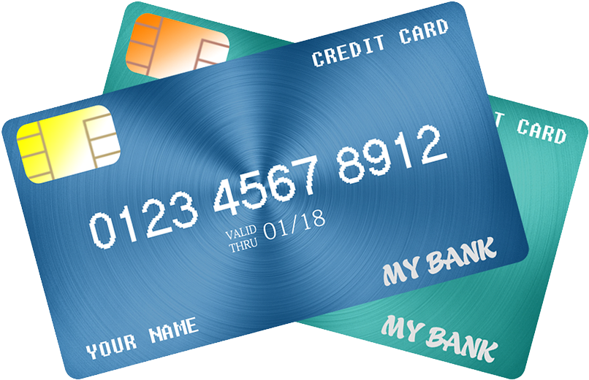
Problem Statement
The bank wants to predict which of the application received by it will be approved using machine learning models. Based on the past data of applications received, we need to predict the application will be approved or rejected.

Slide 3
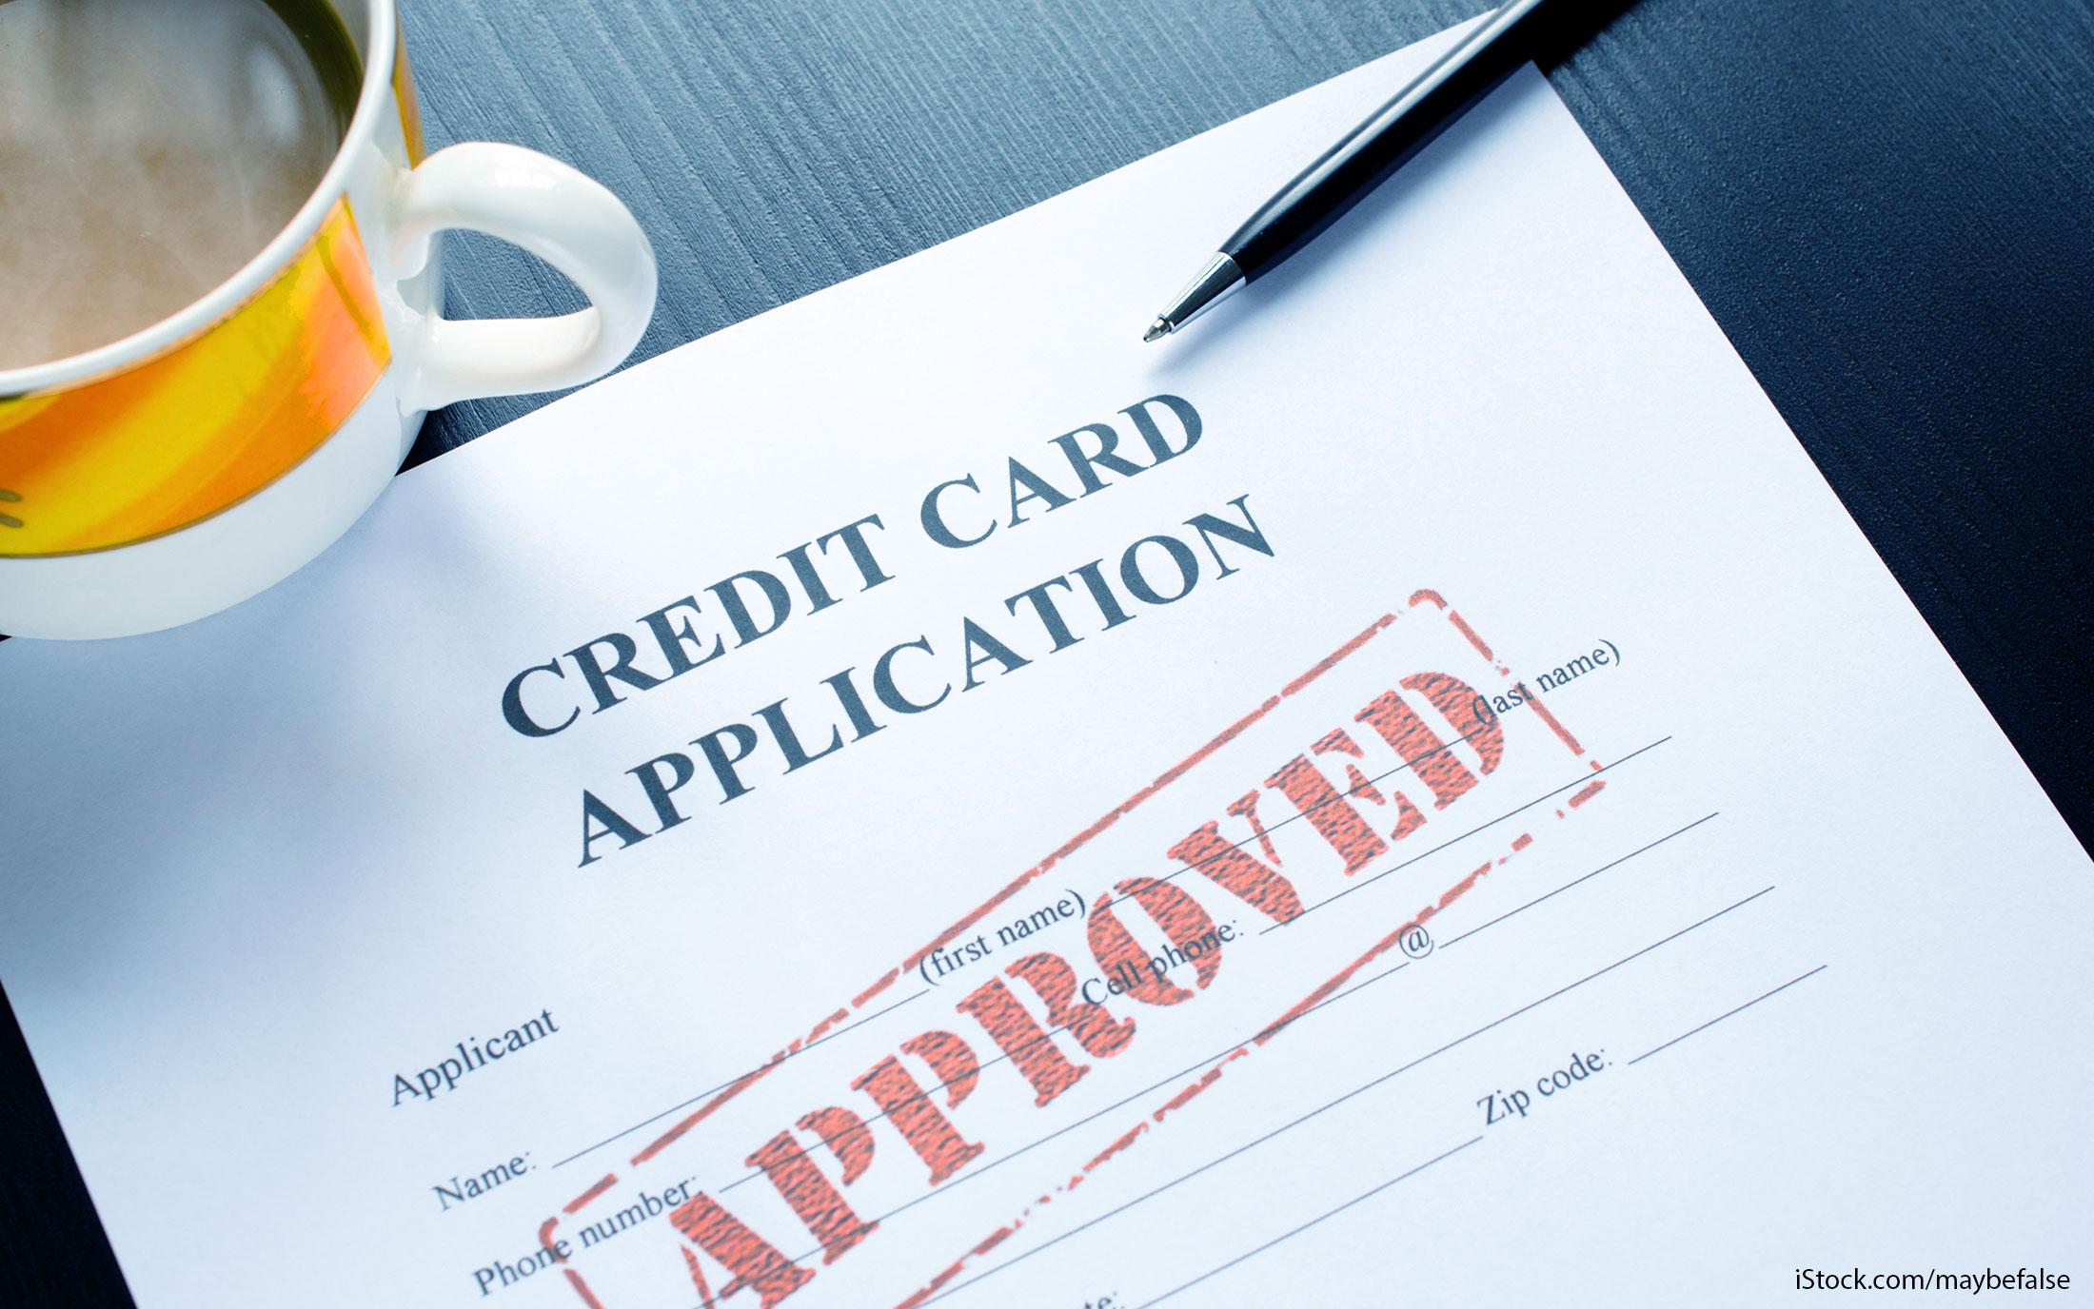
Why it is a important problem
Studying past data provided by bank of the applicants, understanding the dependency of these features onto prediction of approval of an application by deploying classification machine learning algorithms striving for a higher accuracy in prediction.

Slide 4

Value additions we planned
By implementing these models (Logistic Regression, Random Forest, Decision tree, XGBoost) we will try to balance the recall and precision out of which our major concern is recall(Delinquents)
By using our model, Bank would be able to identify between defaulters & non defaulters better before approving the application, which will eventually help them focus on non defaulters for maximizing the revenue for themselves.

Slide 5

Suggested solution for the defined problem
The solution here is a Binary Classification based Machine Learning model. It can be implemented by different classification algorithms (like Logistic Regression, Random Forest, Decision tree, XGBoost and so on. Here first we will be performing Data pre-processing step, in which Data Profiling, feature engineering, feature selection, feature scaling, VIF steps are performed and then we are going to build model.

Slide 6
Data sets considered :
Credit score cards are a common risk control method in the financial industry. It uses personal information and data submitted by credit card applicants to predict the probability of future defaults i.e risky or less risky.
The bank is able to decide whether to issue a credit card to the applicant. Credit scores can objectively quantify the magnitude of risk.
Reference : https://www.kaggle.com/datasets/laotse/credit-card-approval

Slide 7
Feature Name | Description | Remarks
ID | Client Number
CODE_GENDER | Gender
FLAGOWNCAR | Is there a car
FLAGOWNREALTY | Is there a property
CNT_CHILDREN | Number of Children
AMTINCOMETOTAL | Annual Income
NAMEEDUCATIONTYPE | Education Level
NAMEFAMILYSTATUS | Marital Status
NAMEHOUSINGTYPE | Way of Living
DAYS_BIRTH | Age in days
DAYS_EMPLOYED | Duration of work in days
FLAG_MOBIL | Is there a mobile phone
FLAGWORKPHONE | Is there a work phone
FLAG_PHONE | Is there a phone
FLAG_EMAIL | Is there an email
JOB | Job
BEGIN_MONTHS | Record month | The month of the extracted data is the starting point, backwards, 0 is the current month, -1 is the previous month, and so on
STATUS | Status | 0: 1-29 days past due 1: 30-59 days past due 2: 60-89 days overdue 3: 90-119 days overdue 4: 120-149 days overdue 5: Overdue or bad debts, write-offs for more than 150 days C: paid off that month X: No loan for the month
TARGET | Target | Risk user are marked as '1', else are '0'
Data Dictionary

Slide 8
About the Data
There are no null values in the data.
We dropped some irrelevant columns i.e "ID","FLAG_MOBIL","FLAG_WORK_PHONE","FLAG_OWN_CAR","FLAG_OWN_REALTY“
We changed the Target data type as object as it was int in the dataset.
For encoding we used WOE Encoder from feature_engine.encoding library
Dealing missing value with WOE library
We have given missing values a separate class in the feature occupation type

Slide 9
The columns which has No and Yes will be converted to 0's and 1's respectively.
Univariate Analysis: Income is Positively skewed which means there are outliers in the data. Age, Years_employed and Months_applied all are positively skewed.
One Hot Encoding: Encoded the education_type into higher studies and lower studies, Marital_status into married, single and others and Dwelling into independent and dependent.
Bivariate Analysis: Those who fall in category 5 of the column status, their applications are marked as risky which means that status is an important feature in determining whether the credit card application will be approved or not.
Outliers Treatment: There are outliers in Income and Years_employed. We treated outliers using IQR.
Exploratory
Data
Analysis

Slide 10
Feature Extraction/Selection/Engineering:
In JOB feature, we have encoded the categories into 2 categories - Blue collar and White collar jobs.
In Name_Housing_type feature, we have encoded the categories into 2 categories-
Dependent and non-dependent.
In Name_Family_Status, we have encoded the categories into 3 categories as Married, Single and Others. Where others are:- Divorced or Separated applicants.
In Name_Education_Type, we have encoded the catgeories into 2 categories- Higher education and lower education.
In CNT_CHILDREN, Since there are only 3 unique values no feature extraction has been done.

Slide 11
Scaling the Data:
ROBUST SCALER
This Scaler removes the median and scales the data according to the quantile range (defaults to IQR: Interquartile Range). The IQR is the range between the 1st quartile (25th quantile) and the 3rd quartile (75th quantile).
Centring and scaling happen independently on each feature by computing the relevant statistics on the samples in the training set. Median and interquartile range are then stored to be used on later data using the transform method.
Standardization of a dataset is a common requirement for many machine learning estimators. Typically this is done by removing the mean and scaling to unit variance. However, outliers can often influence the sample mean / variance in a negative way. In such cases, the median and the interquartile range often give better results.

Slide 12
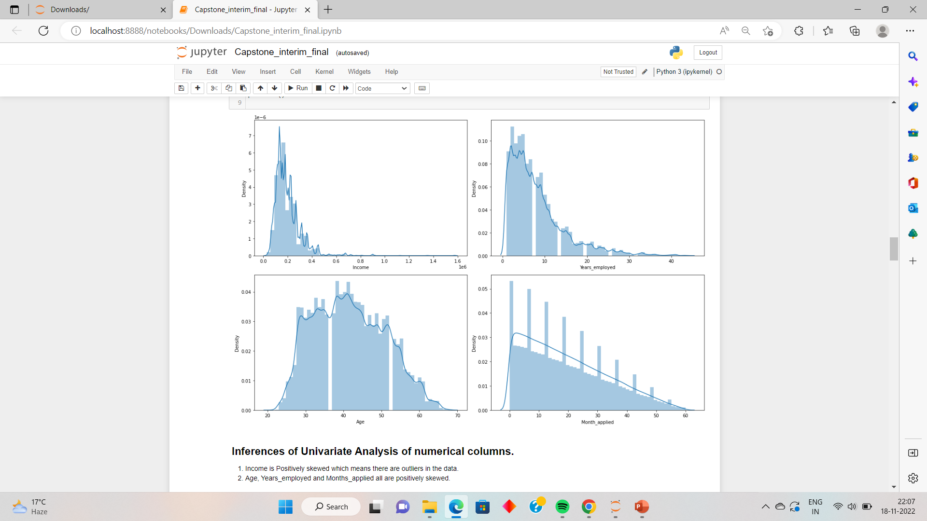
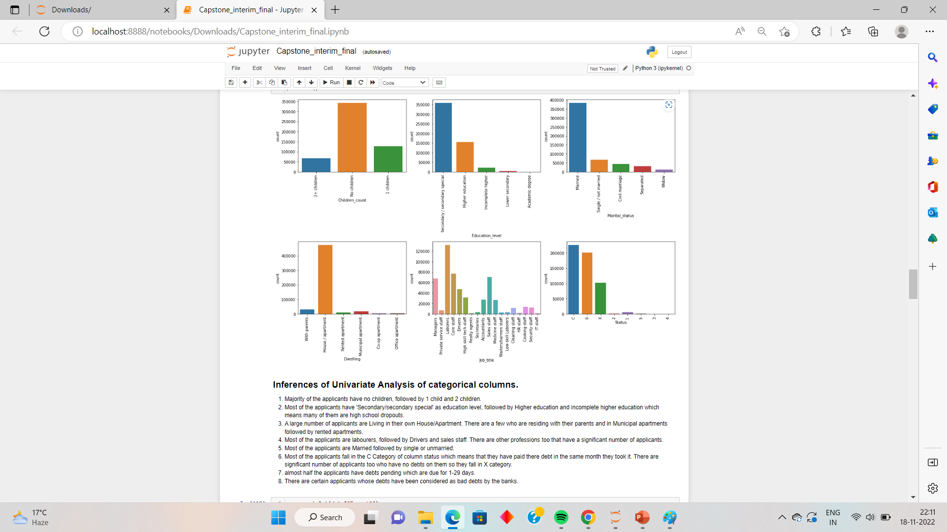
Univariate Analysis
Inferences →

Slide 13
Inferences for Univariate Analysis
1. Majority of the applicants have no children, followed by 1 child and 2 children.
2. Most of the applicants have 'Secondary/secondary special' as education level, followed by Higher education and incomplete higher education which means many of them are high school dropouts.
3. A large number of applicants are Living in their own House/Apartment. There are a few who are residing with their parents and in Municipal apartments followed by rented apartments.
4. Most of the applicants are laborer, followed by Drivers and sales staff. There are other professions too that have a significant number of applicants.
5. Most of the applicants are Married followed by single or unmarried.
6. Most of the applicants fall in the C Category of column status which means that they have paid there debt in the same month they took it. There are significant number of applicants too who have no debts on them so they fall in X category.
7. almost half the applicants have debts pending which are due for 1-29 days.
8. There are certain applicants whose debts have been considered as bad debts by the banks.

Slide 14
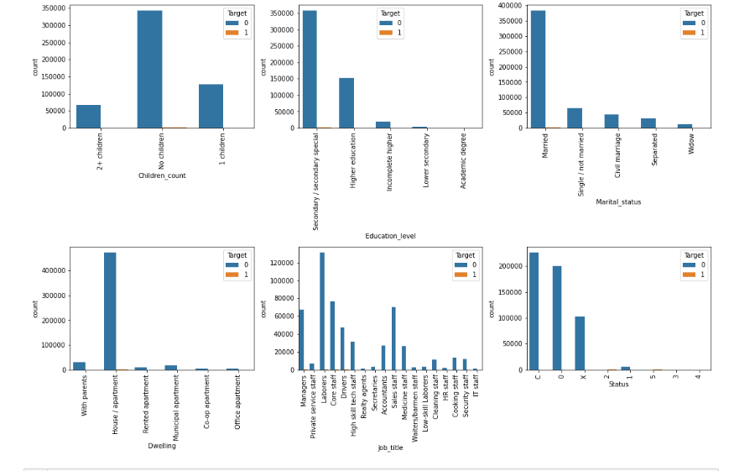
Bivariate Analysis
Inferences →

Slide 15
Inferences for Bivariate Analysis
Almost every application has been marked as not risky but there are some application of applicants who have no children but are married and their education level is Secondary schooling.
These Users live in their own House/Apartment.
Those whose applications are marked as risky come from various professions. Few of them are Managers, Laborer, Core staff and Drivers. There are applicants from other profession too but they are negligible.
Those who fall in category 5 of the column status, their applications are marked as risky which means that status is an important feature in determining whether the credit card application will be approved or not.
There are almost negligible application received in 3 and 4 category of status column.

Slide 16
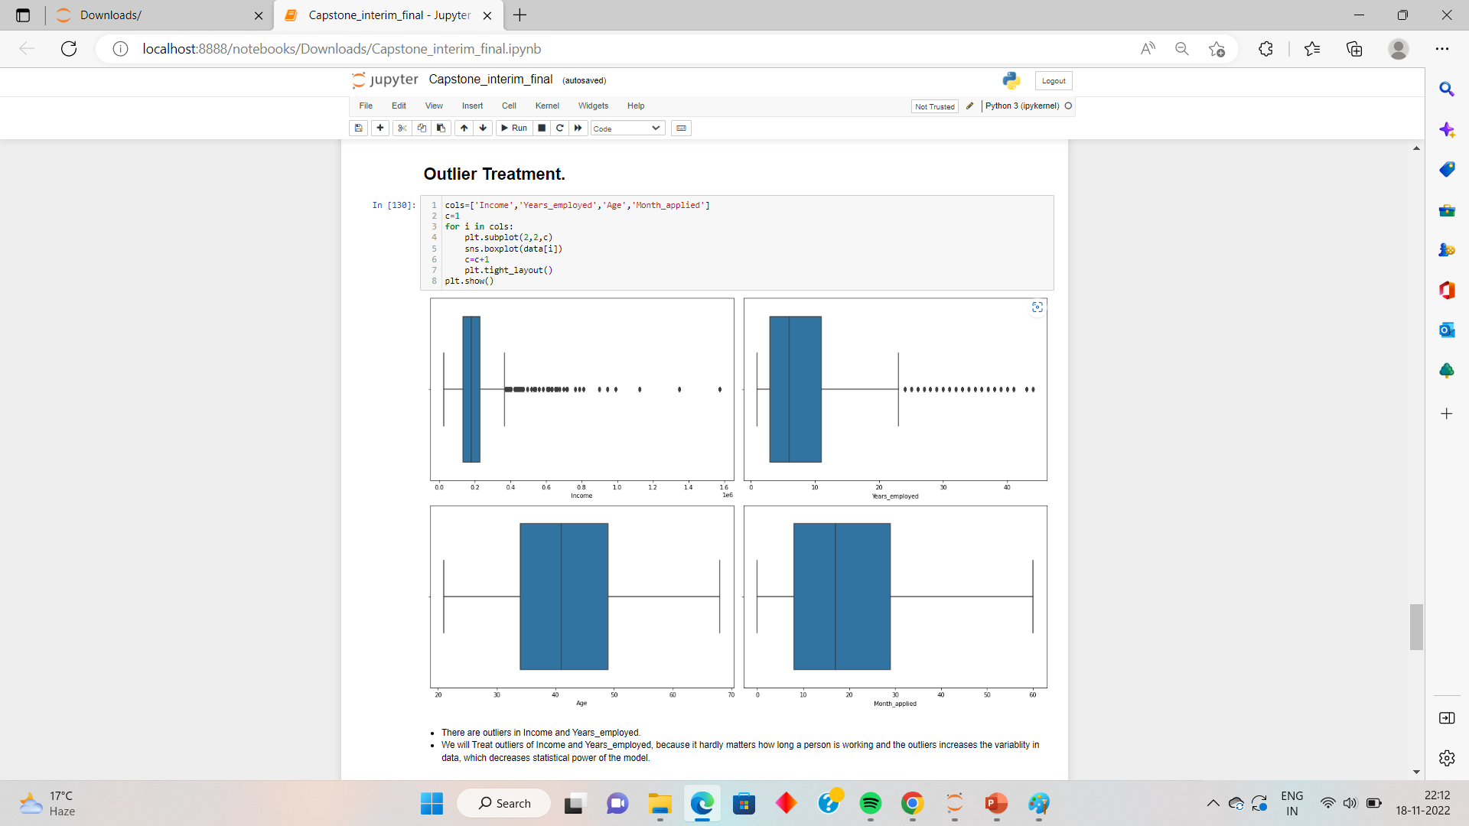
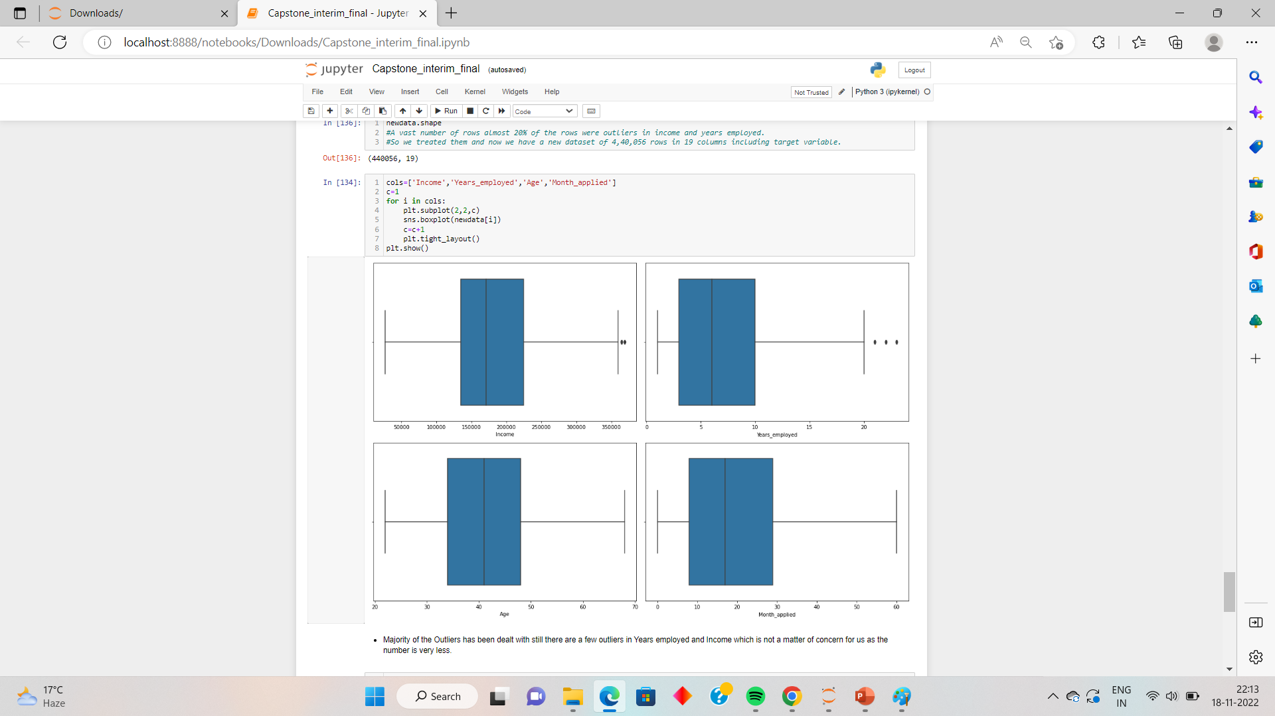
Before
Outliers Treatment
There are outliers in the dataset.
We treated outliers using IQR.
It can be seen in the image that the outliers are reduced.
After

Slide 17
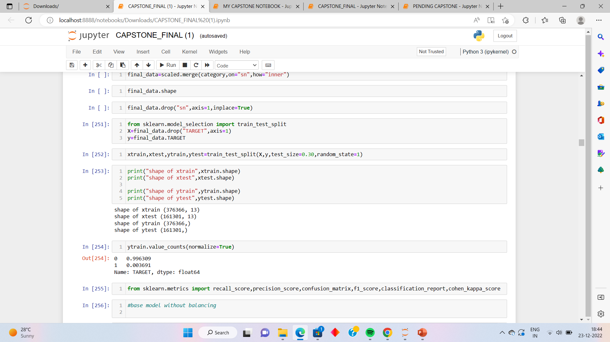
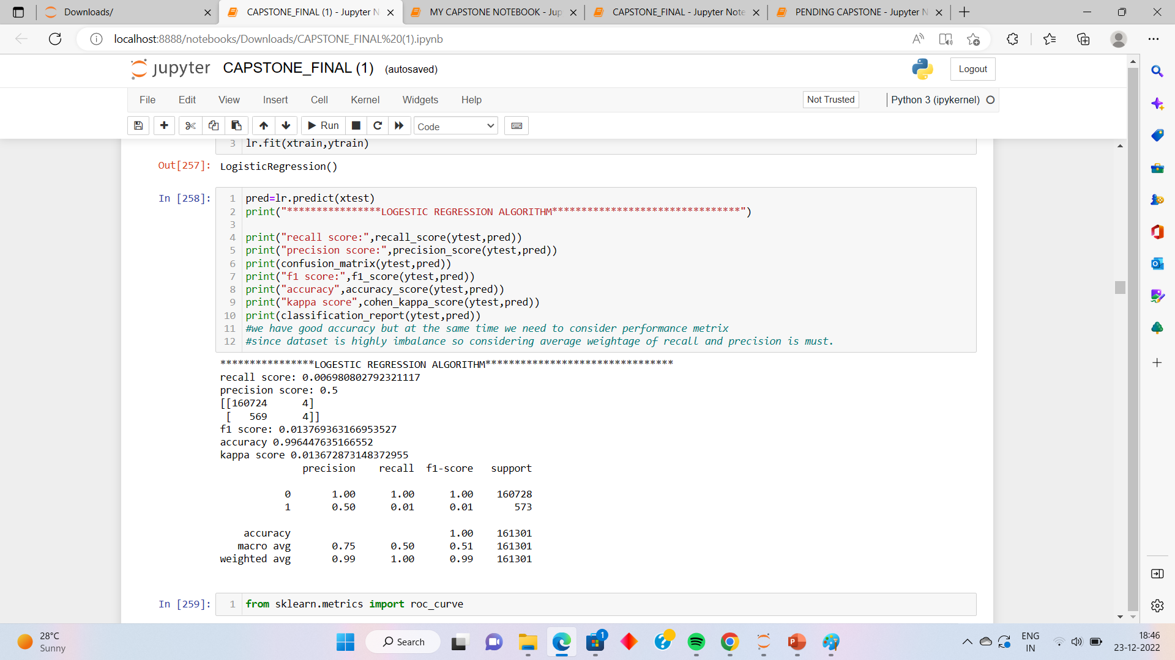
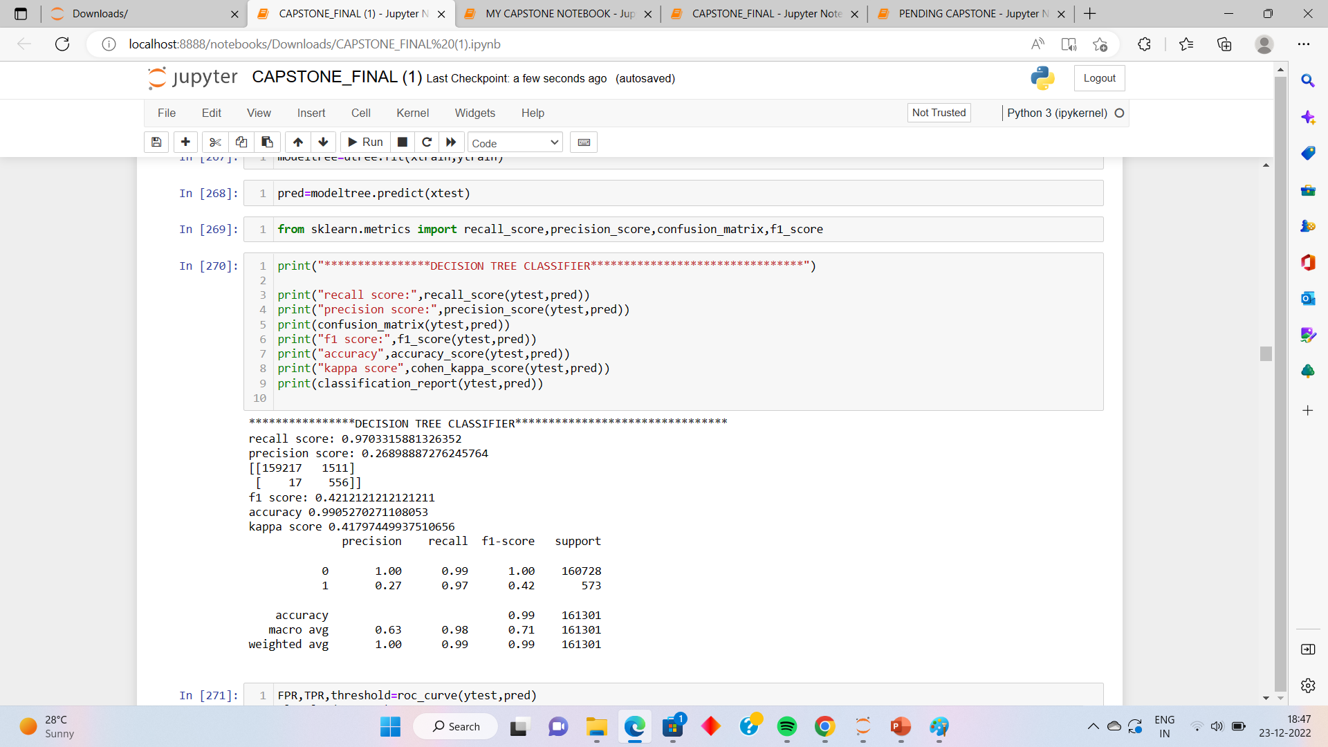
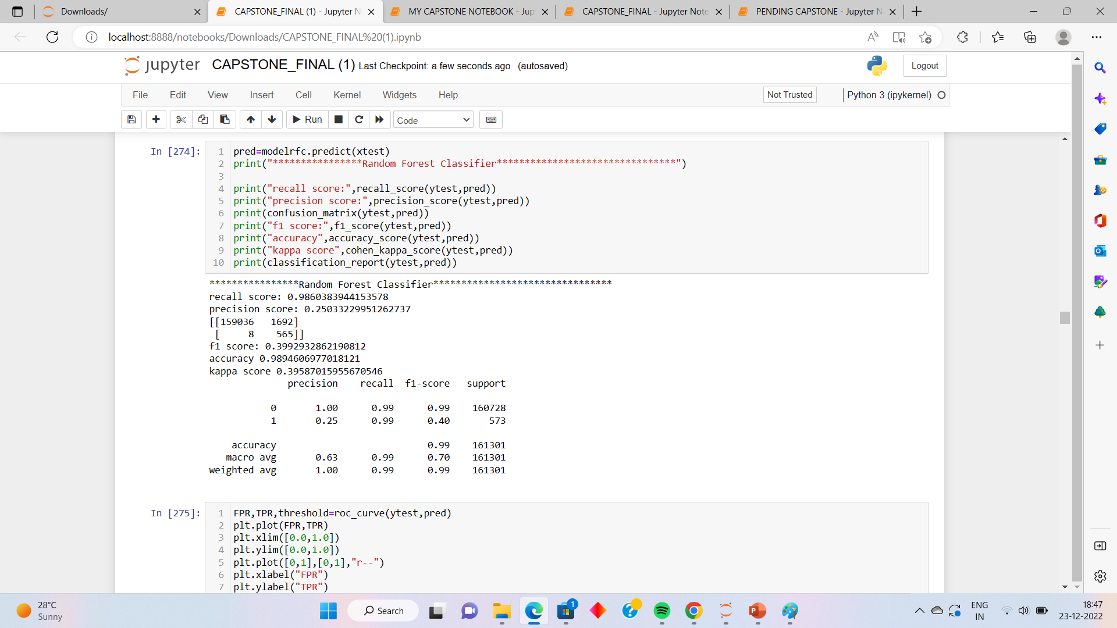
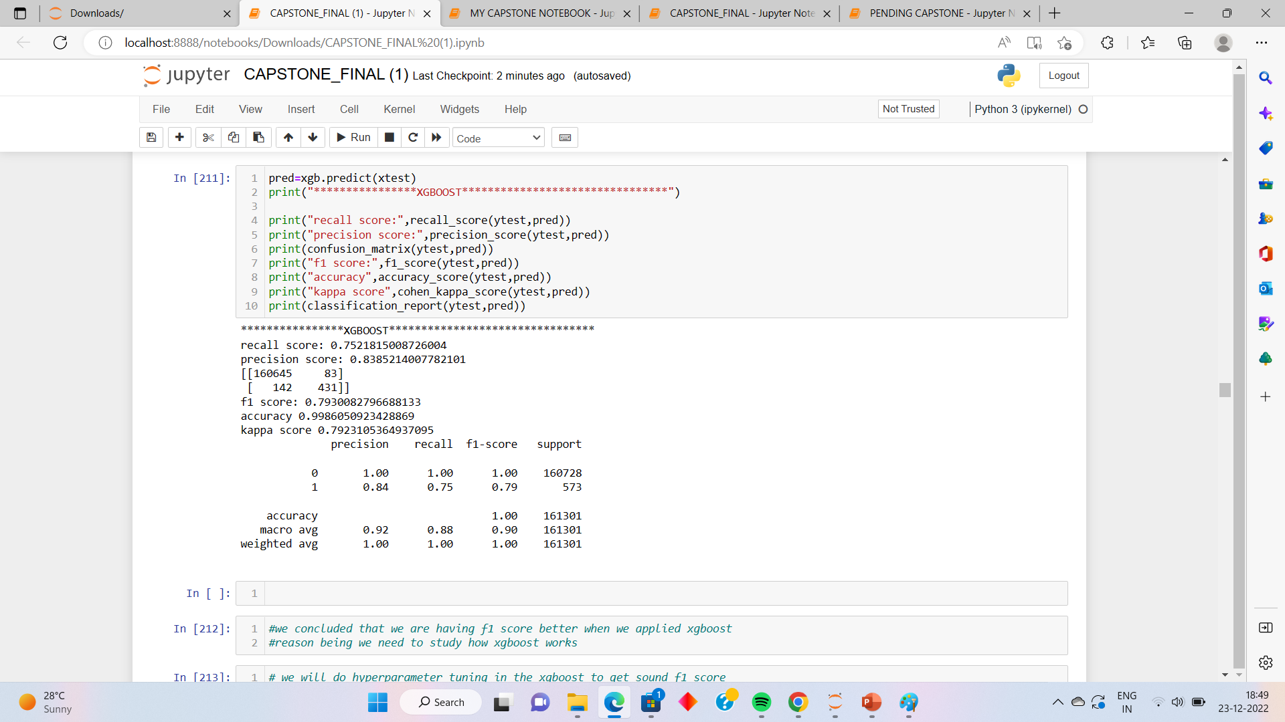
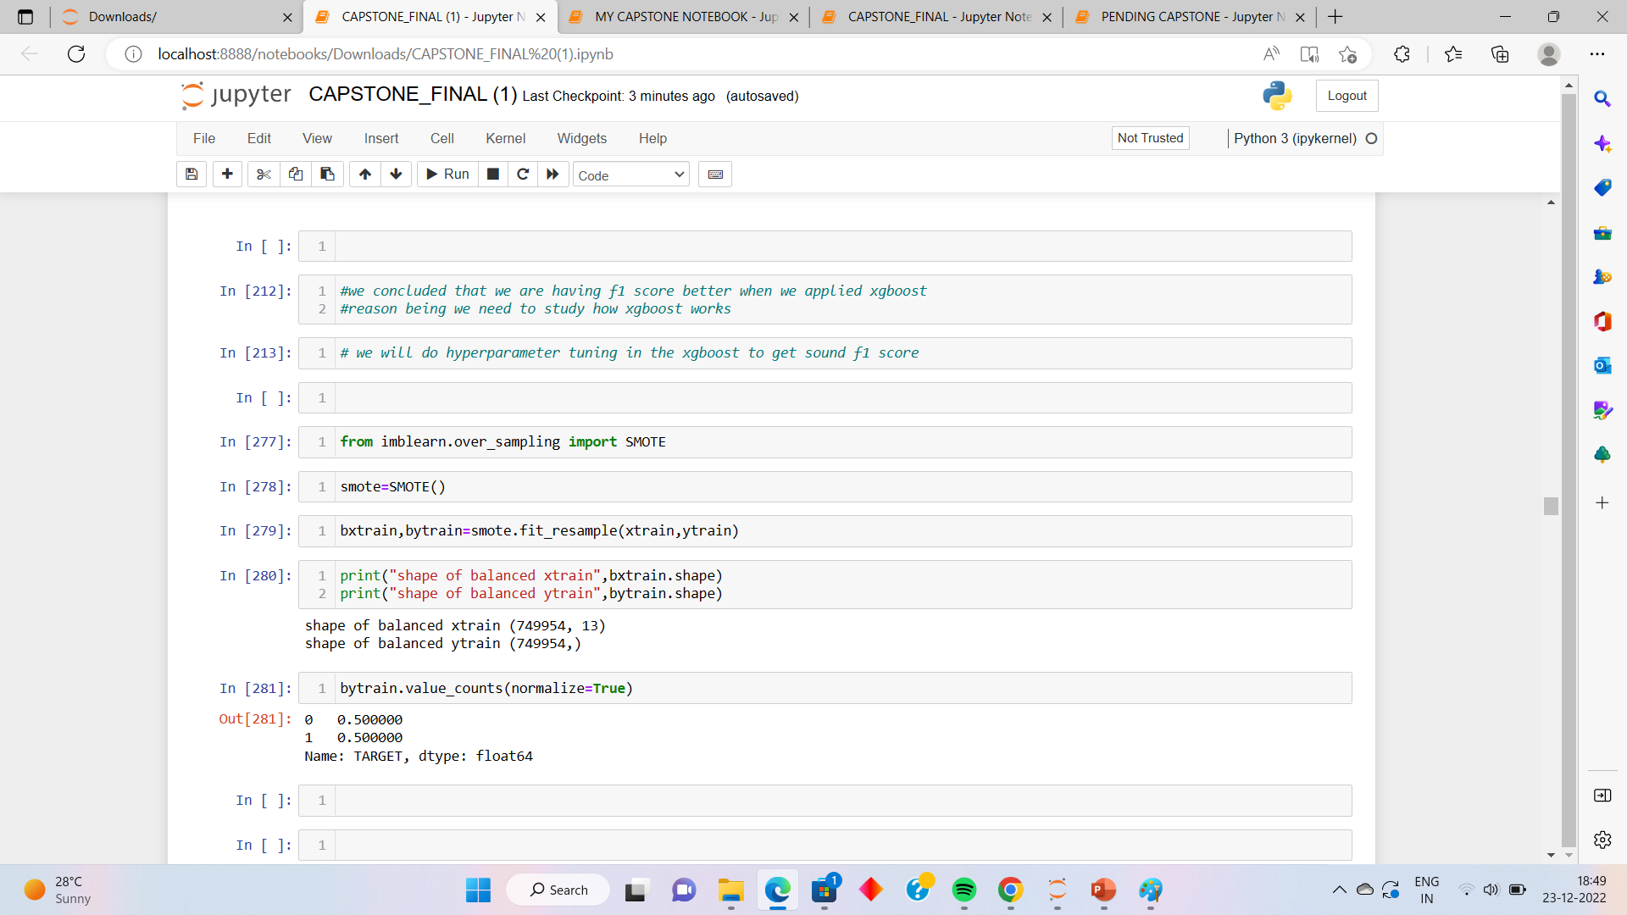
Before Balancing the Data
Data Shape of Imbalanced data Base Model Decision Tree
Random Forest XGBoost Applying 100% SMOTE for equal ratio of 1s and 0s

Slide 18
Hyperparameter Tuning on Imbalanced Data
RANDOMIZED SEARCH CV-
Randomized search on hyper parameters.
RandomizedSearchCV implements a “fit” and a “score” method. It also implements “score_samples”, “predict”, “predict_proba”, “decision_function”, “transform” and “inverse_transform” .
if they are implemented in the estimator used.The parameters of the estimator used to apply these methods are optimized by cross-validated search over parameter settings.
The f1 score of the model is 78% and the best score comes out to be 99%.

Slide 19
Some Important Terminologies
Cohen Kappa Score: It is a statistic used to measure the agreement between two raters. It can be used to calculate how much agreement is there between raters on a scale from 0-1, with 1 being perfect agreement and 0 being no agreement at all. The higher the score, the more agreement there is between the raters.
Accuracy Score: Accuracy classification score. In multilabel classification, this function computes subset accuracy: the set of labels predicted for a sample must exactly match the corresponding set of labels in y_true.
F1-Score: F1 score (F-measure) is an evaluation metric, that is used to express the performance of the machine learning model (or classifier). It gives the combined information about the precision and recall of a model. This means a high F1-score indicates a high value for both recall and precision.
Precision and recall: Precision and recall are two numbers which together are used to evaluate the performance of classification or information retrieval systems. Precision is defined as the fraction of relevant instances among all retrieved instances. Recall, sometimes referred to as ‘sensitivity, is the fraction of retrieved instances among all relevant instances.

Slide 20
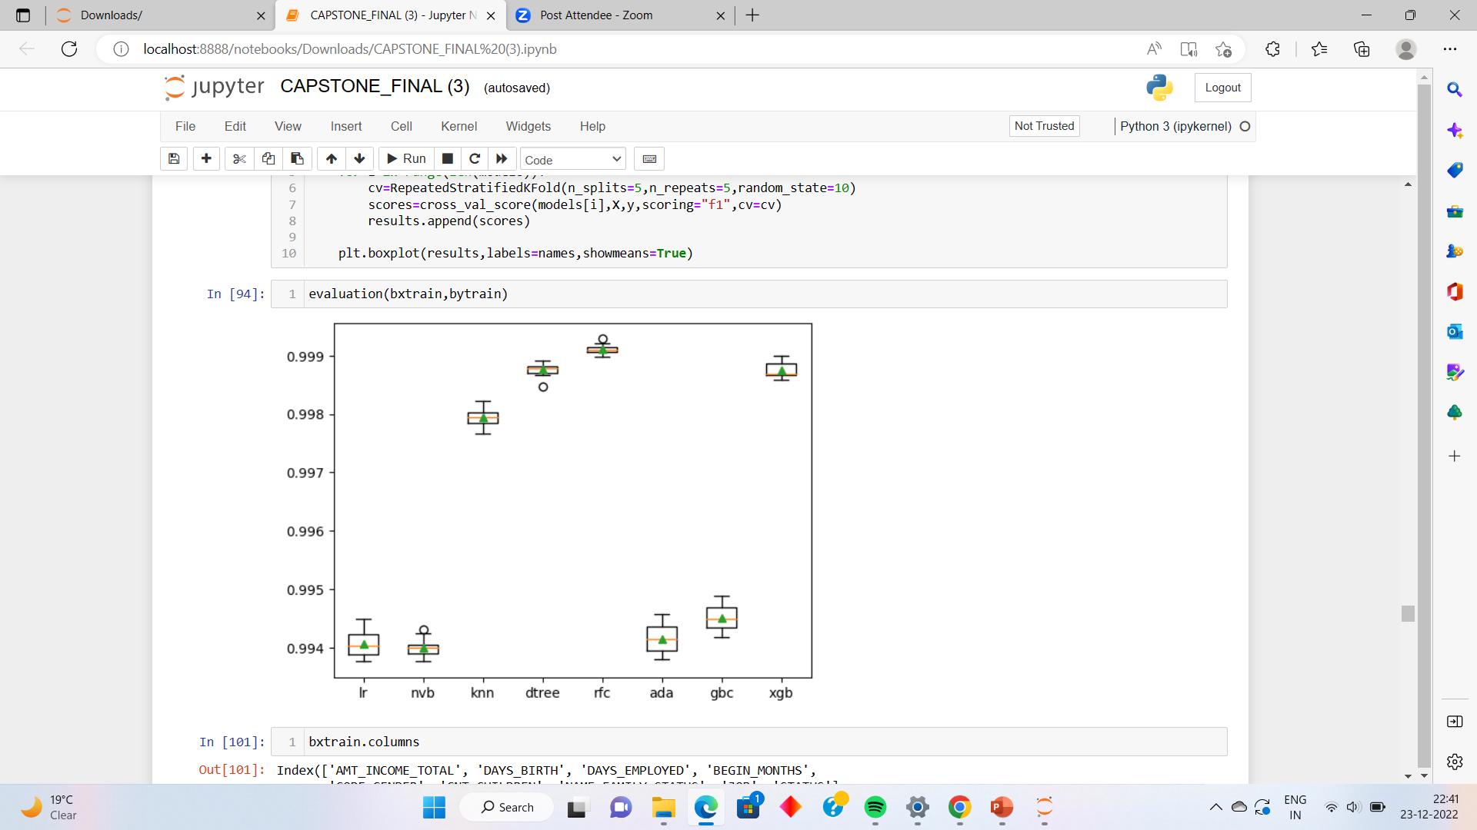
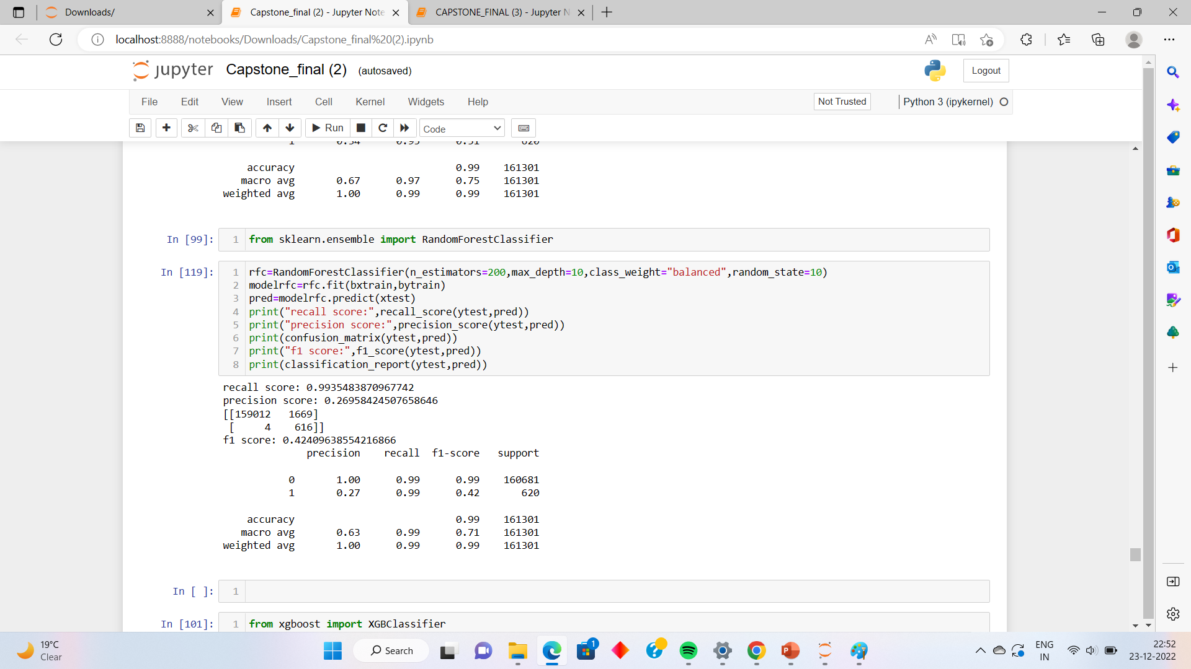
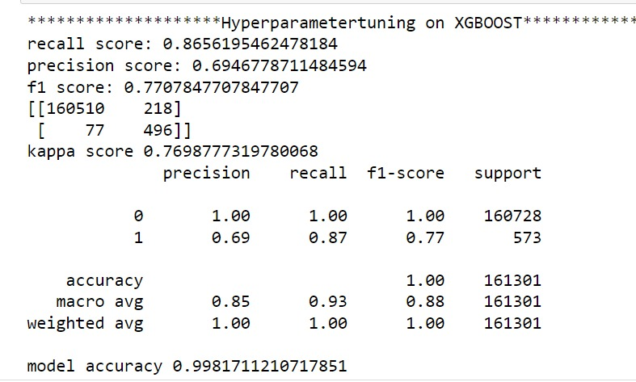
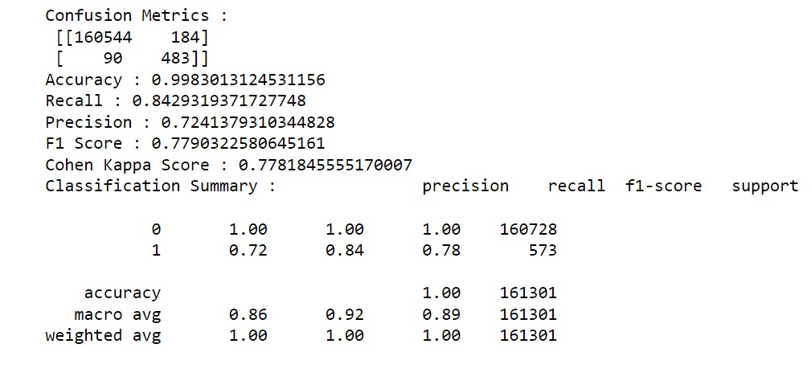
Final model building with balanced data and hyperparameter tuning
Final Model
Random oversampler on RFC
Model performance scoring = F1 score
Final Model with better parameters

Slide 21
Models Comparison
1. DECISION TREE CLASSIFIER-
Decision Tree is a Supervised learning technique that can be used for both classification and Regression problems, but mostly it is preferred for solving Classification problems. It is a tree-structured classifier, where internal nodes represent the features of a dataset, branches represent the decision rules and each leaf node represents the outcome.
The accuracy is 99% in Decision Tree Modelling.
2. Random Forest Classifier-
Random forest classifier creates a set of decision trees from randomly selected subset of training set. It then aggregates the votes from different decision trees to decide the final class of the test object. In Laymen’s term, So finally, it predicts based on the majority of votes from each of the decision trees made.
The accuracy in this model is 98%.
3. XGB CLASSIFIER-
Classification Example with XGBClassifier in Python. The XGBoost stands for eXtreme Gradient Boosting, which is a boosting algorithm based on gradient boosted decision trees algorithm. XGBoost applies a better regularization technique to reduce overfitting, and it is one of the differences from the gradient boosting.
The accuracy with XGB Classifier is 99.8%.

Slide 22

Gradient Boosting is improvised to make it Extreme. XGBoost is a tree based ensemble machine learning algorithm which is a scalable machine learning system for tree boosting. XGBoost stands for Extreme Gradient Boosting. It uses more accurate approximations to find the best tree model.
The accuracy is the highest with the XGBoost Classifier Hyper Parameter Tuning Model with 99.8%.
Why XGBoost ?

Slide 23

Conclusion
After implementing the hyperparameter tuning on XGboost we recevied highest recall and precision at the same time.#we tried adjusting the threshold but the maximum f1score recived was through xgboost.
Again we adjusted the hyperparamter on xgboost to get the trade off point.

Slide 24




How to use this presentation
GOOGLE SLIDES
POWERPOINT
CANVA
Click on the "Google Slides" button below this presentation preview. Click on "Make a copy." Start editing your presentation. You need to sign in to your Google account.
Click on the "PowerPoint" button below this presentation preview.
Start editing your presentation.
Download and install the fonts used in this presentation as listed on page 21.
Click on the "Canva" button under this presentation preview. Start editing your presentation. You need to sign in to your Canva account.

